Slide 1


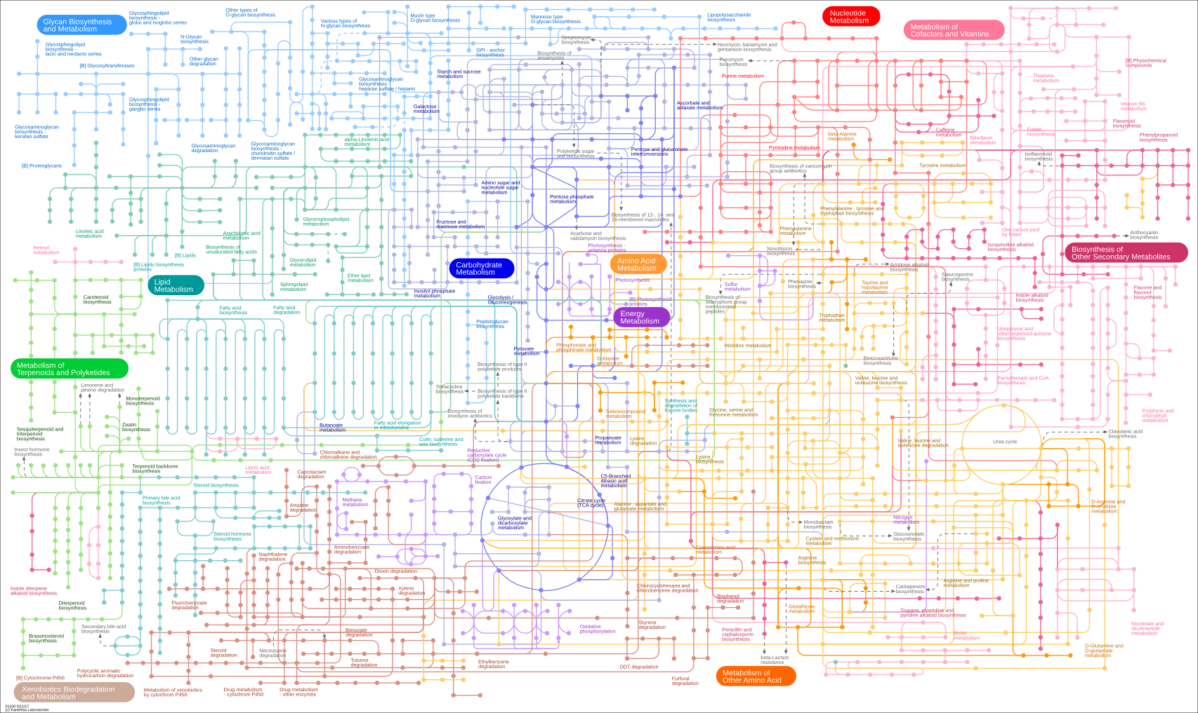


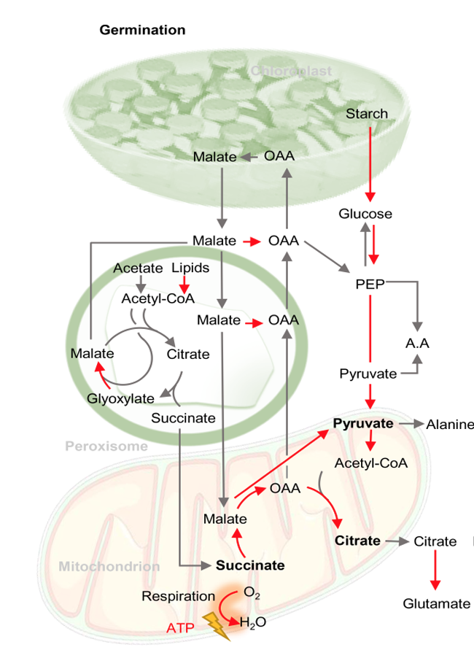
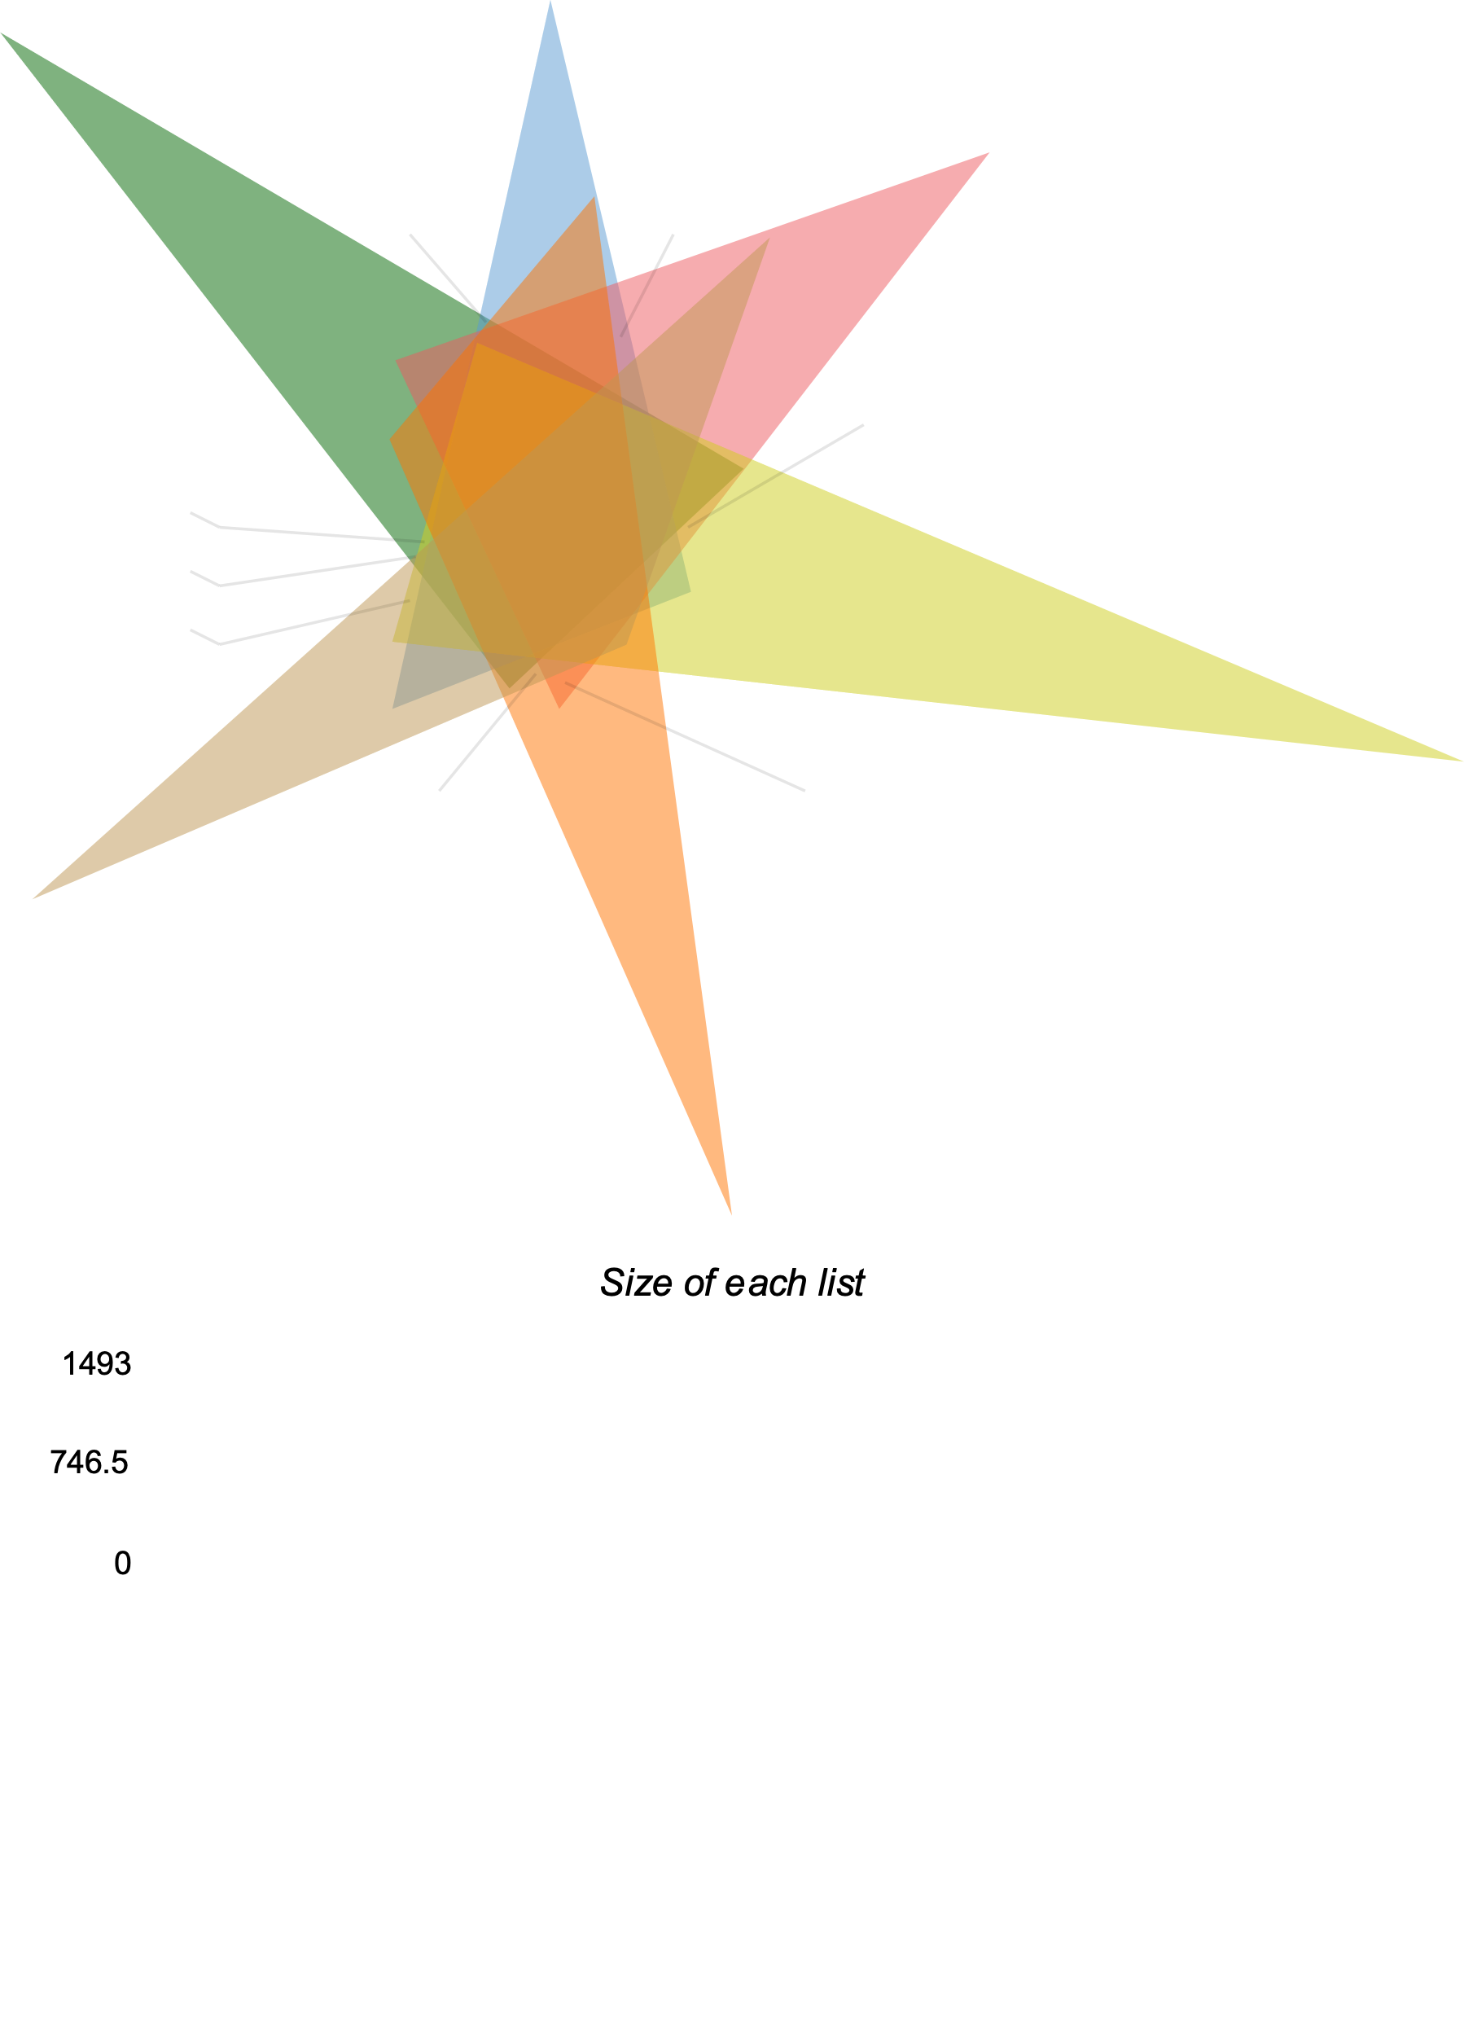
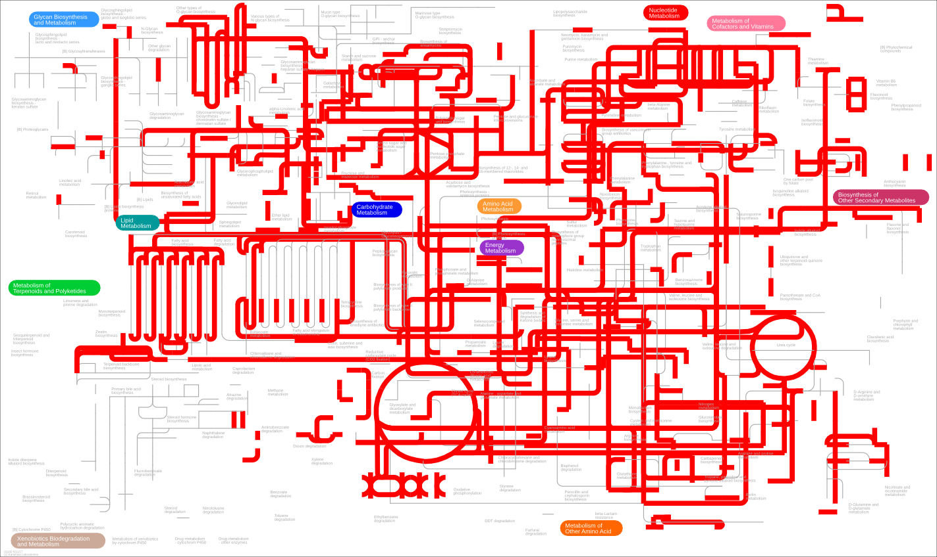
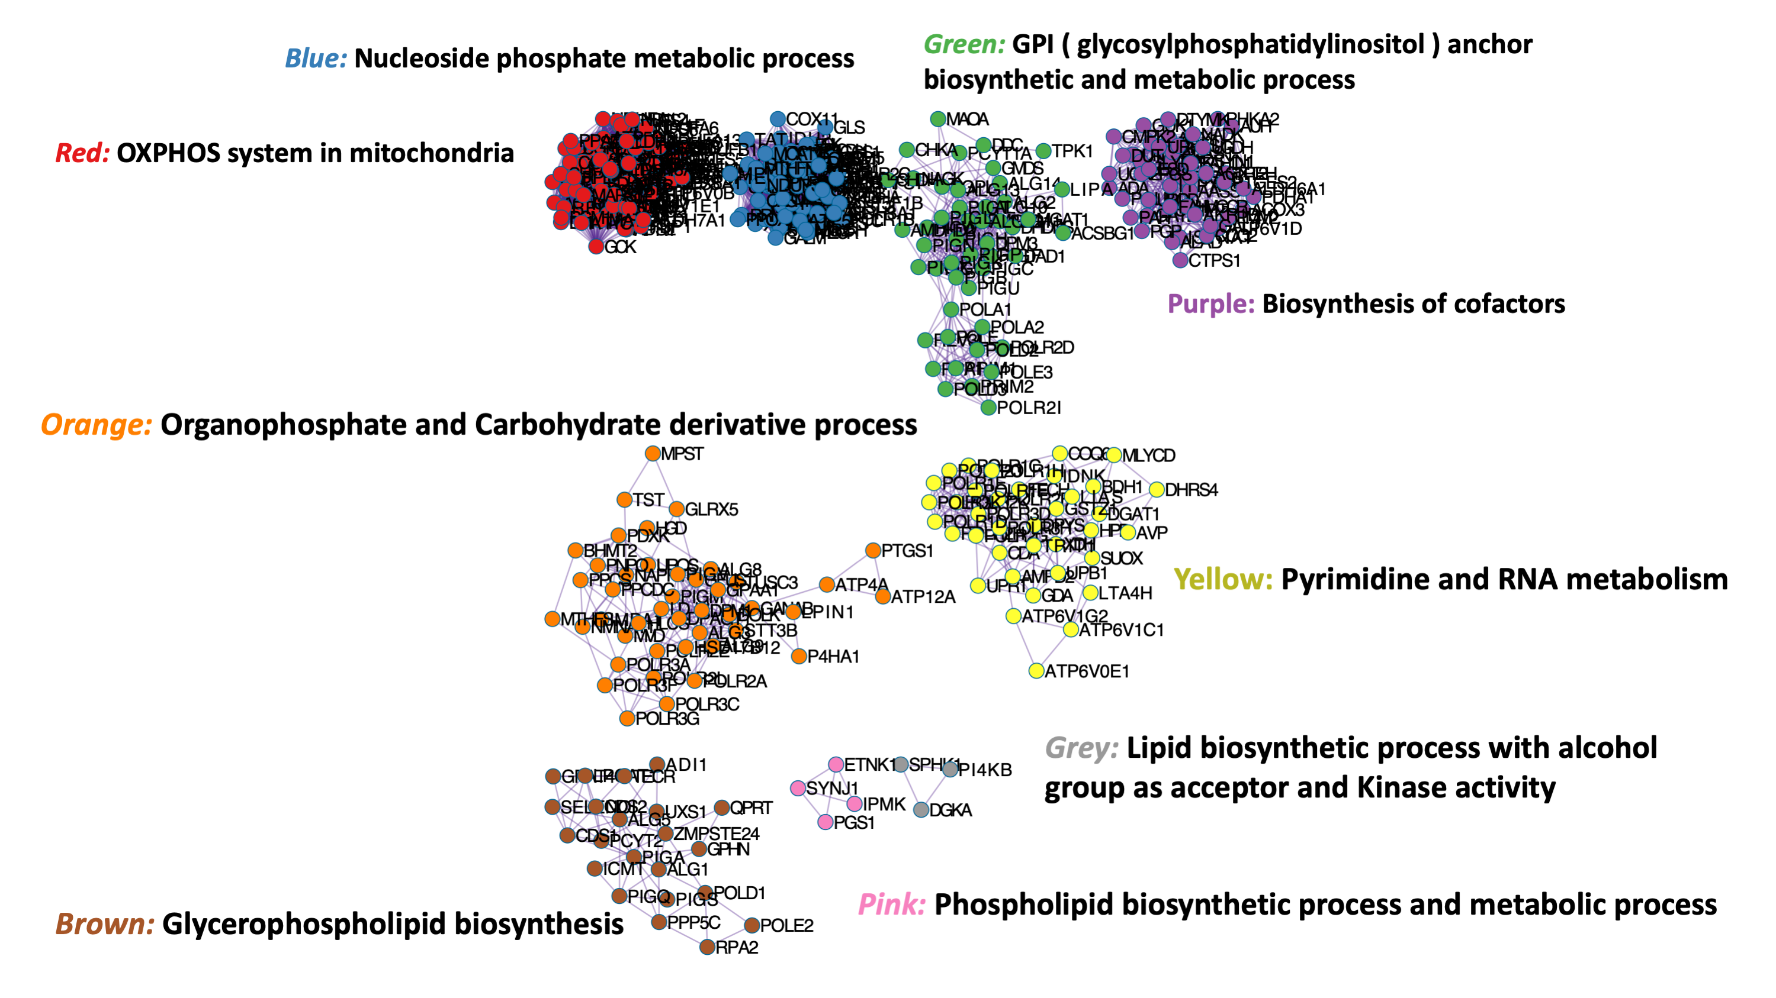
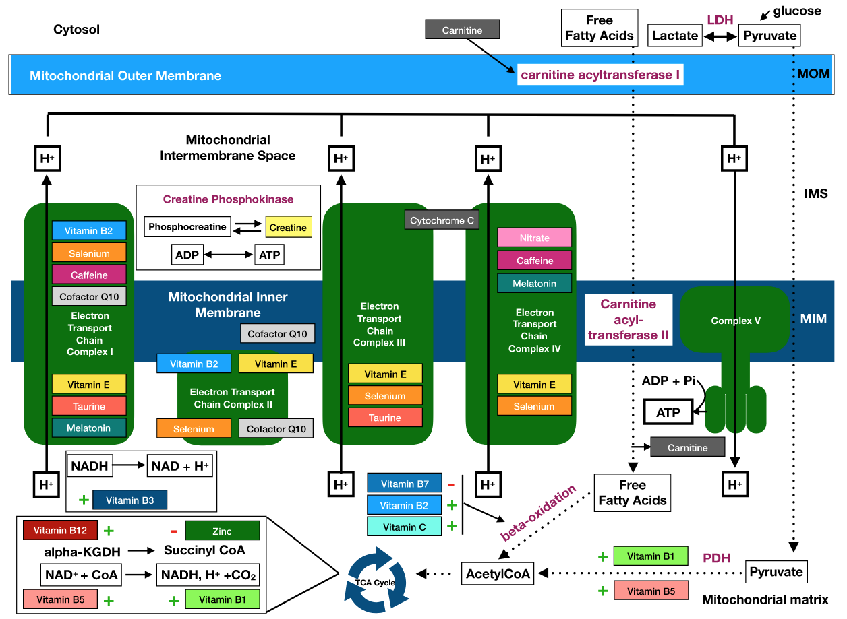
Comparison of KEGG pathways 4 EMPIRE
https://pathways.embl.de/ -> Log in -> Go to the “Tools”
ARA, HSA, DME , MUS
466 KEGG Path “KO” ID’s pulled from I PATH3
VENN diagram used to intersect 4 EMPIRE organisms
KO ID had 812 gene ID’s identified
Gene ID annotation pulled during metascape analysis
MCODE identifies 9 core clusters

Slide 2
Is there a conserved core metabolism for “EMPIRE”?
Metabolism summary figure from iPath3

Slide 3
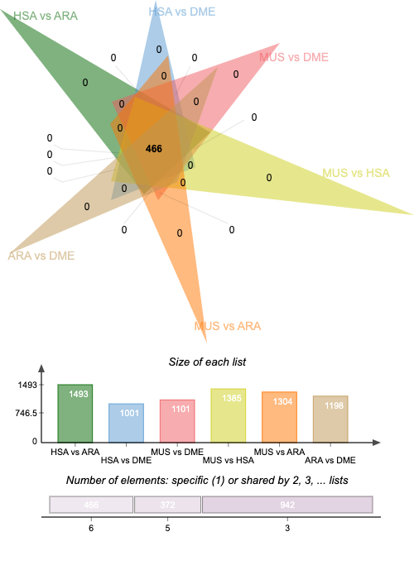
Pair Wise comparison of ARA, HSA, 7227 (Fruit fly), MUS
Idenitfy core pathways from pairwise pathway intersect analysis in iPATH3

Slide 4
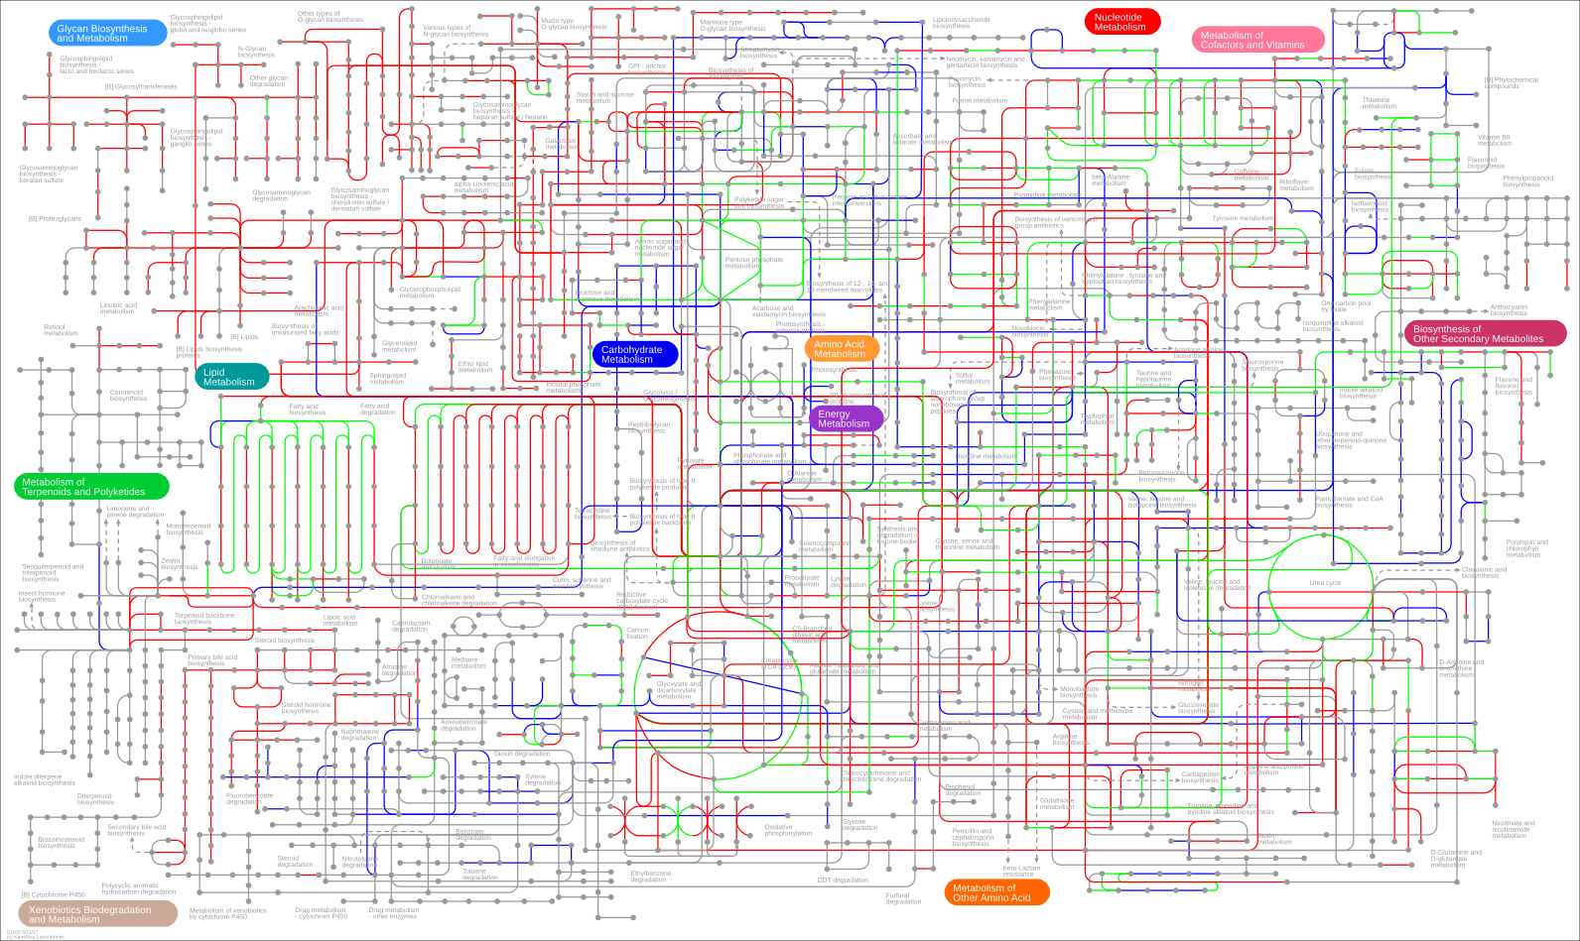
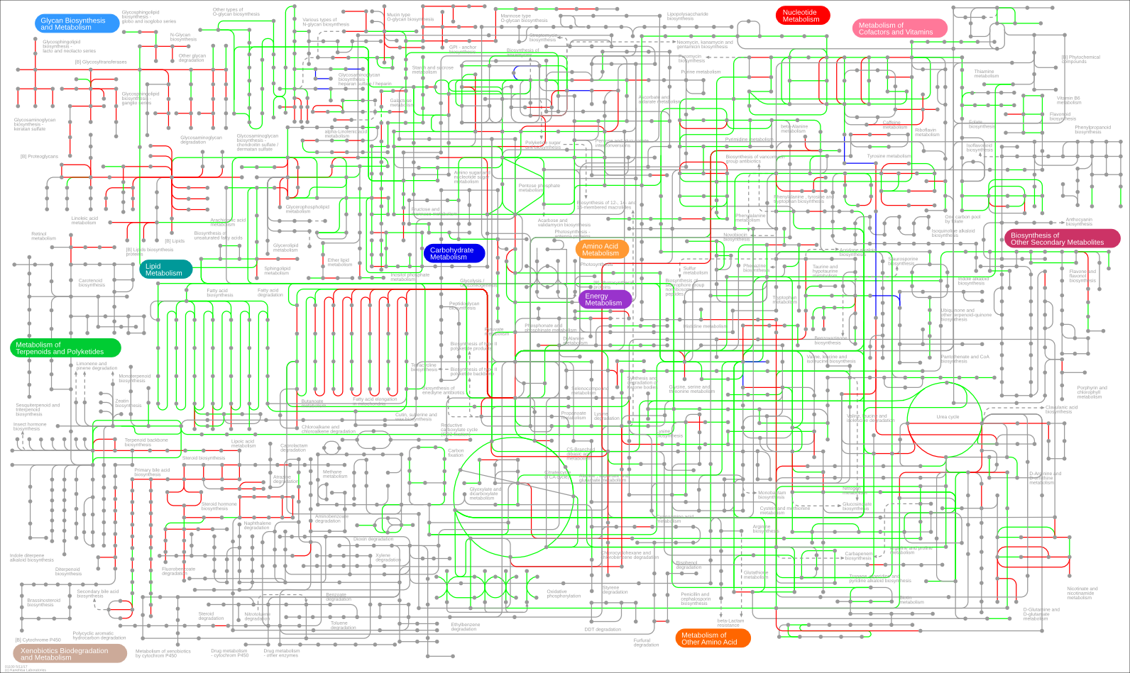
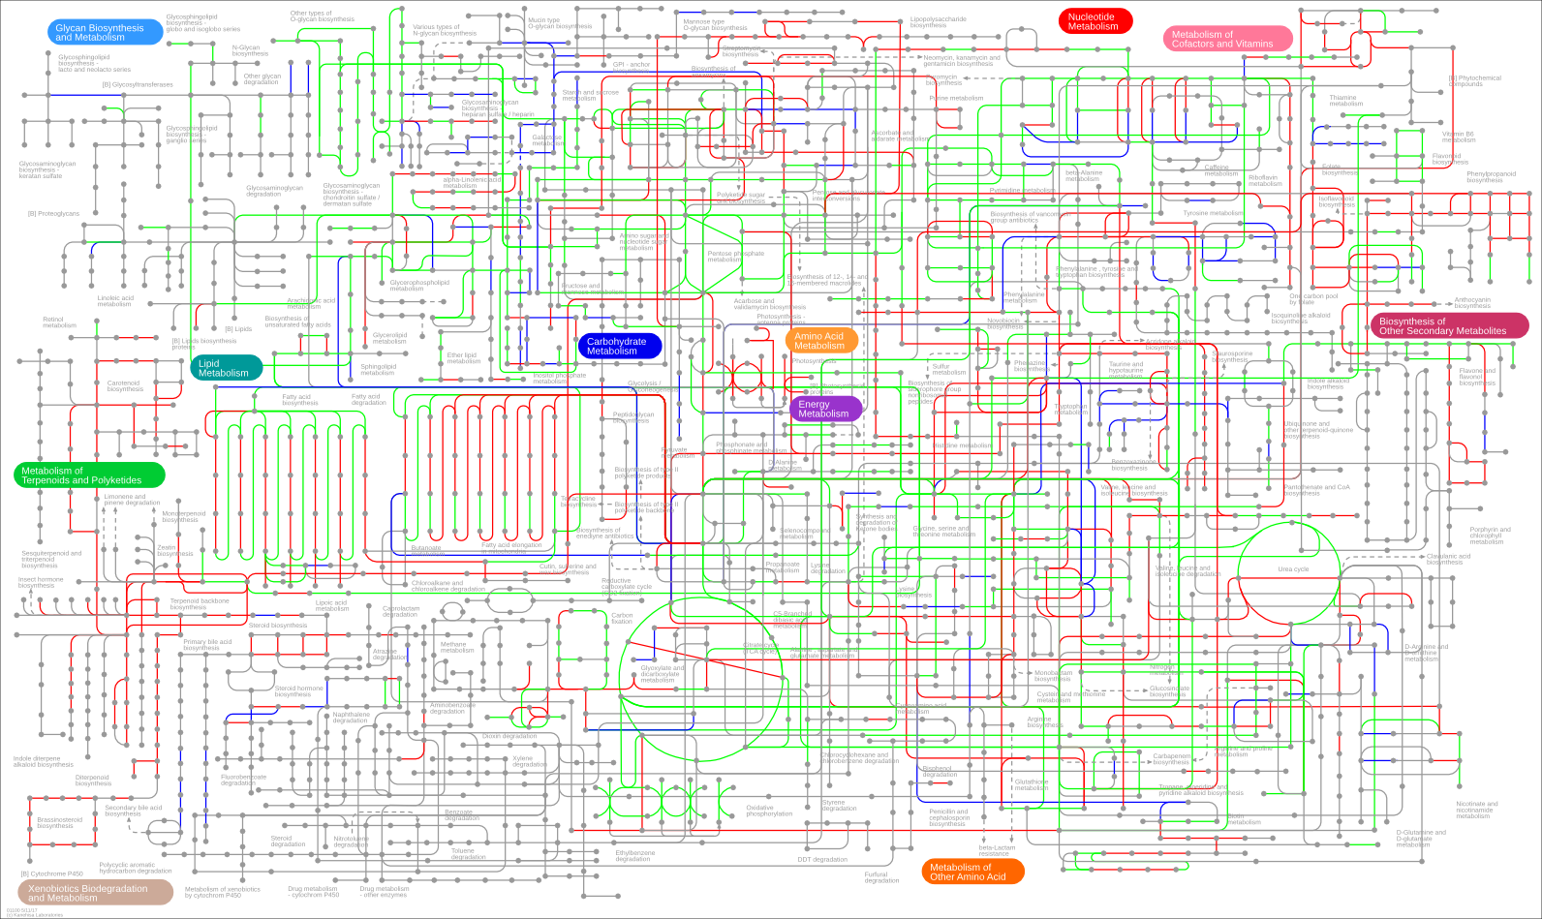
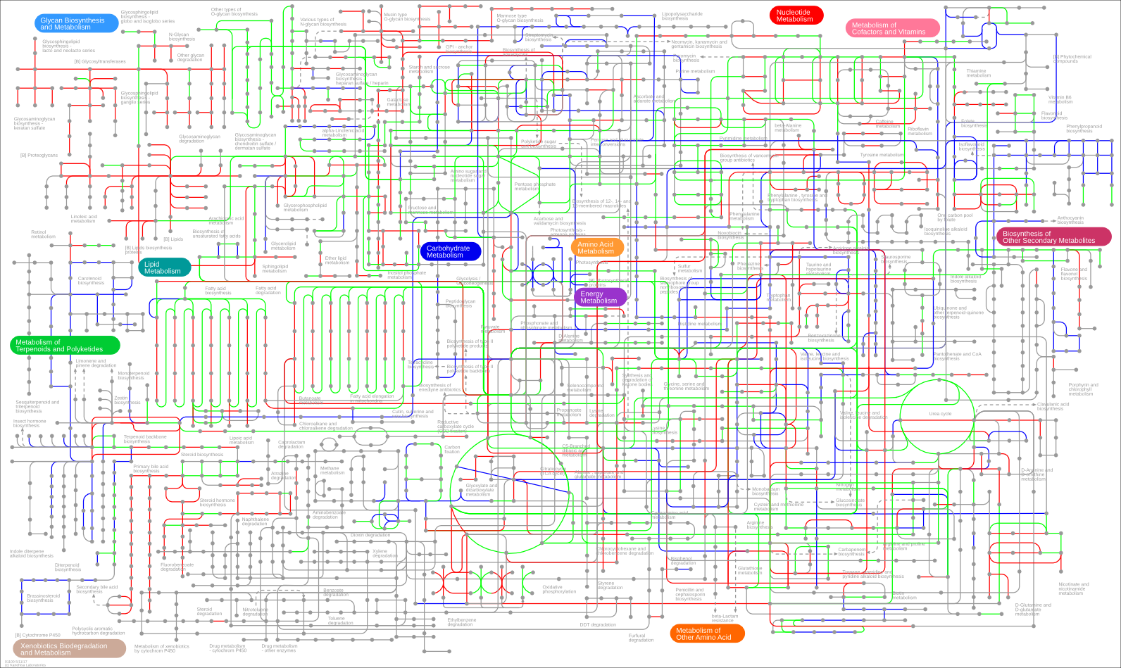
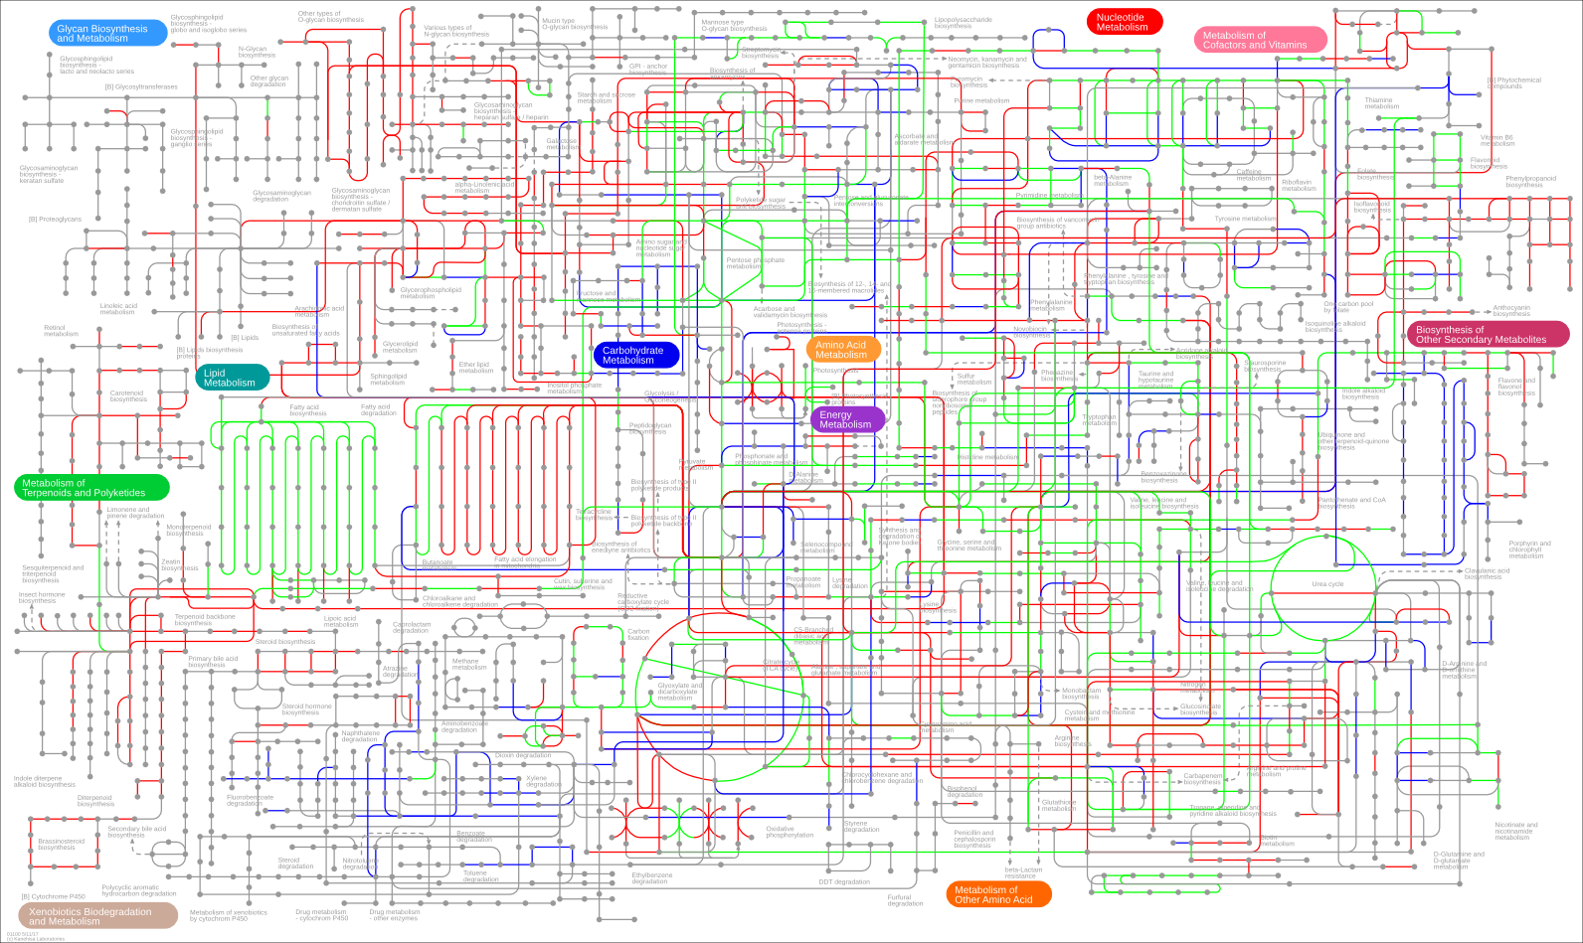
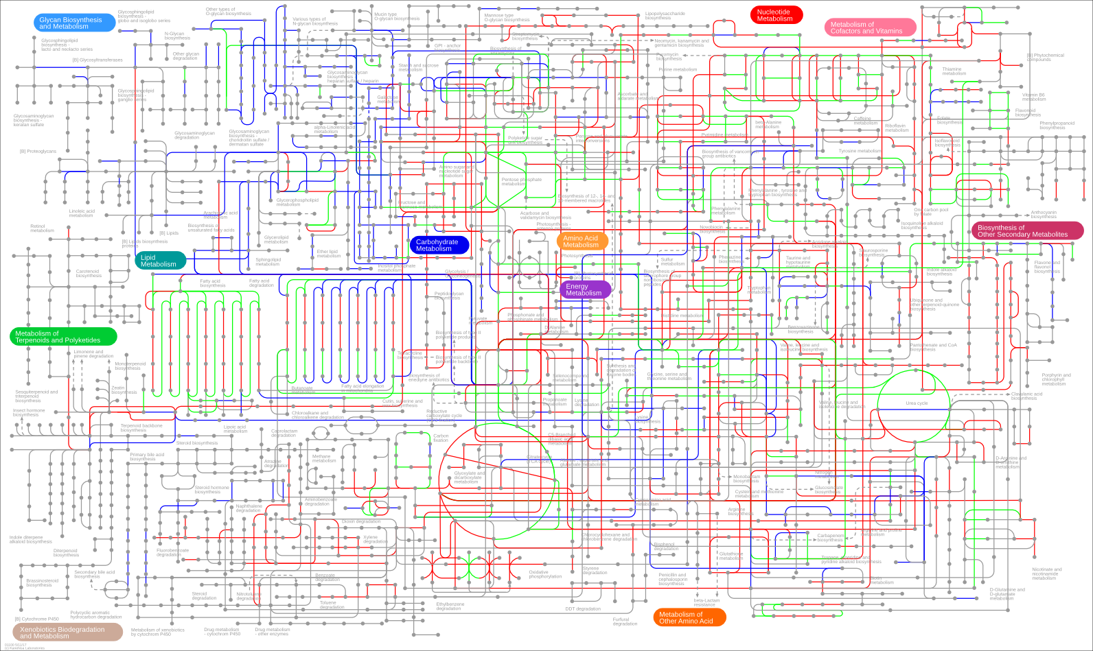

Slide 5
466 conserved KO
812 loci

Slide 6
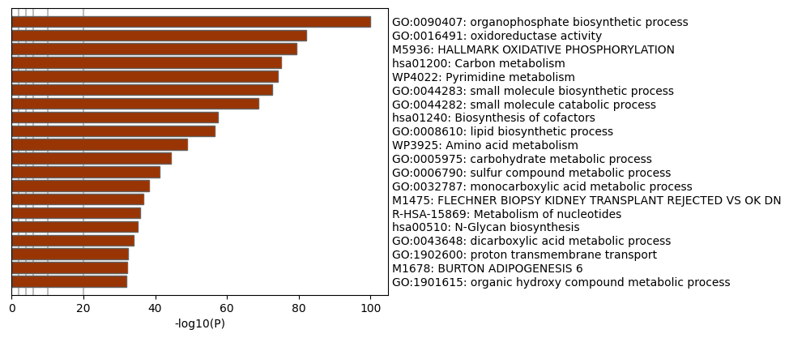
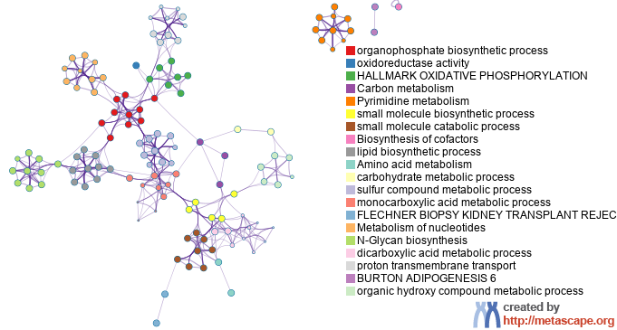
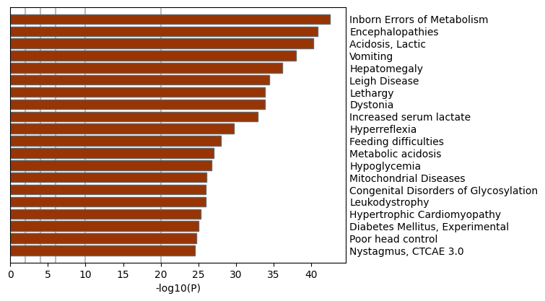
Meta-scape summary of pathway

Slide 7
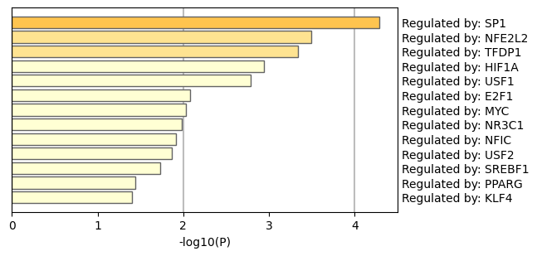
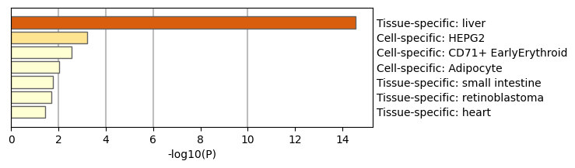
Meta-scape description of “Core metabolism”

Slide 8
Meta-scape description of “Core metabolism”
MyList 812 loci | GO:0090407|organophosphate biosynthetic process|-100.0;GO:0019693|ribose phosphate metabolic process|-100.0;GO:0009259|ribonucleotide metabolic process|-100.0
MyList_MCODE_ALL | GO:0090407|organophosphate biosynthetic process|-100.0;GO:0019693|ribose phosphate metabolic process|-100.0;GO:0009259|ribonucleotide metabolic process|-100.0
MyList_SUB1_MCODE_1 | GO:0006091|generation of precursor metabolites and energy|-100.0;hsa00190|Oxidative phosphorylation|-92.7;WP111|Electron transport chain: OXPHOS system in mitochondria|-81.5
MyList_SUB1_MCODE_2 | GO:0055086|nucleobase-containing small molecule metabolic process|-43.1;GO:0009117|nucleotide metabolic process|-40.2;GO:0006753|nucleoside phosphate metabolic process|-39.9
MyList_SUB1_MCODE_3 | GO:0006506|GPI anchor biosynthetic process|-34.3;GO:0006505|GPI anchor metabolic process|-34.0;GO:1901137|carbohydrate derivative biosynthetic process|-33.2
MyList_SUB1_MCODE_4 | hsa01240|Biosynthesis of cofactors|-18.8;GO:0055086|nucleobase-containing small molecule metabolic process|-18.2;GO:0090407|organophosphate biosynthetic process|-14.6
MyList_SUB1_MCODE_5 | GO:0090407|organophosphate biosynthetic process|-16.7;hsa00510|N-Glycan biosynthesis|-16.5;GO:1901137|carbohydrate derivative biosynthetic process|-14.6
MyList_SUB1_MCODE_6 | WP4022|Pyrimidine metabolism|-31.5;hsa03020|RNA polymerase|-29.9;GO:0003899|DNA-directed 5'-3' RNA polymerase activity|-26.9
MyList_SUB1_MCODE_7 | GO:0090407|organophosphate biosynthetic process|-15.3;GO:0046474|glycerophospholipid biosynthetic process|-14.0;GO:0045017|glycerolipid biosynthetic process|-13.6
MyList_SUB1_MCODE_8 | GO:0046474|glycerophospholipid biosynthetic process|-8.7;GO:0045017|glycerolipid biosynthetic process|-8.6;GO:0008654|phospholipid biosynthetic process|-8.4
MyList_SUB1_MCODE_9 | GO:0008610|lipid biosynthetic process|-5.1;GO:0016773|phosphotransferase activity, alcohol group as acceptor|-5.0;GO:0016301|kinase activity|-4.9
_FINAL | GO:0090407|organophosphate biosynthetic process|-100.0;GO:0019693|ribose phosphate metabolic process|-100.0;GO:0009259|ribonucleotide metabolic process|-100.0

Slide 9
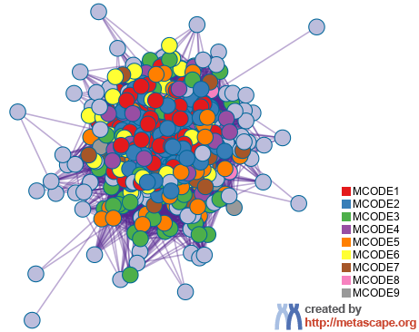
MetaScape protein interaction summary
GEGC cluster identification
GO:0090407|organophosphate biosynthetic process
GO:0019693|ribose phosphate metabolic process
GO:0009259|ribonucleotide metabolic process

Slide 10
Network MCODE | Annotation
_FINAL_MCODE_ALL | GO:0090407|organophosphate biosynthetic process|-100.0;GO:0019693|ribose phosphate metabolic process|-100.0;GO:0009259|ribonucleotide metabolic process|-100.0
_FINAL_SUB1_MCODE_1 | GO:0006091|generation of precursor metabolites and energy|-100.0;hsa00190|Oxidative phosphorylation|-92.7;WP111|Electron transport chain: OXPHOS system in mitochondria|-81.5
_FINAL_SUB1_MCODE_2 | GO:0055086|nucleobase-containing small molecule metabolic process|-43.1;GO:0009117|nucleotide metabolic process|-40.2;GO:0006753|nucleoside phosphate metabolic process|-39.9
_FINAL_SUB1_MCODE_3 | GO:0006506|GPI anchor biosynthetic process|-34.3;GO:0006505|GPI anchor metabolic process|-34.0;GO:1901137|carbohydrate derivative biosynthetic process|-33.2
_FINAL_SUB1_MCODE_4 | hsa01240|Biosynthesis of cofactors|-19.0;GO:0055086|nucleobase-containing small molecule metabolic process|-18.4;GO:0090407|organophosphate biosynthetic process|-14.7
_FINAL_SUB1_MCODE_5 | GO:0090407|organophosphate biosynthetic process|-16.9;hsa00510|N-Glycan biosynthesis|-16.6;GO:1901137|carbohydrate derivative biosynthetic process|-14.7
_FINAL_SUB1_MCODE_6 | WP4022|Pyrimidine metabolism|-31.5;hsa03020|RNA polymerase|-29.9;GO:0003899|DNA-directed 5'-3' RNA polymerase activity|-26.9
_FINAL_SUB1_MCODE_7 | GO:0090407|organophosphate biosynthetic process|-15.3;GO:0046474|glycerophospholipid biosynthetic process|-14.0;GO:0045017|glycerolipid biosynthetic process|-13.6
_FINAL_SUB1_MCODE_8 | GO:0046474|glycerophospholipid biosynthetic process|-8.7;GO:0045017|glycerolipid biosynthetic process|-8.6;GO:0008654|phospholipid biosynthetic process|-8.4
_FINAL_SUB1_MCODE_9 | GO:0008610|lipid biosynthetic process|-5.1;GO:0016773|phosphotransferase activity, alcohol group as acceptor|-5.0;GO:0016301|kinase activity|-4.9

Slide 11
Blue: Nucleoside phosphate metabolic process
Nucleobase-containing small molecule metabolic process
Purple: Biosynthesis of cofactors
nucleobase-containing small molecule metabolic process
organophosphate biosynthetic process
Red: Oxidative phosphorylation
Generation of precursor metabolites and energy
Electron transport chain: OXPHOS system in mitochondria
Green: GPI anchor biosynthetic process
GPI anchor metabolic process
Carbohydrate derivative biosynthetic process
Orange: Organophosphate biosynthetic process
Carbohydrate derivative biosynthetic process
N-Glycan biosynthesis
Yellow: Pyrimidine metabolism
RNA polymerase
DNA-directed 5'-3' RNA polymerase activity
Grey: Kinase activity
Lipid biosynthetic process
Phosphotransferase activity, alcohol group as acceptor
Brown: Glycerolipid biosynthetic process
organophosphate biosynthetic process
glycerophospholipid biosynthetic process
Pink: Glycerophospholipid biosynthetic process
Glycerolipid biosynthetic process
Phospholipid biosynthetic process

Slide 12
Blue: Nucleoside phosphate metabolic process
Green: GPI ( glycosylphosphatidylinositol ) anchor biosynthetic and metabolic process
Red: OXPHOS system in mitochondria
Purple: Biosynthesis of cofactors
Orange: Organophosphate and Carbohydrate derivative process
Yellow: Pyrimidine and RNA metabolism
Grey: Lipid biosynthetic process with alcohol group as acceptor and Kinase activity
Brown: Glycerophospholipid biosynthesis
Pink: Phospholipid biosynthetic process and metabolic process

Slide 13
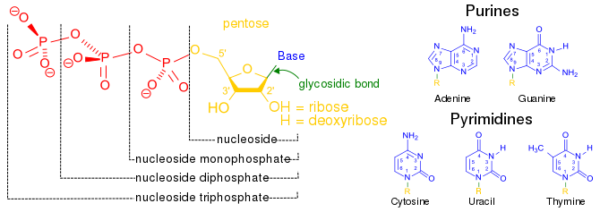
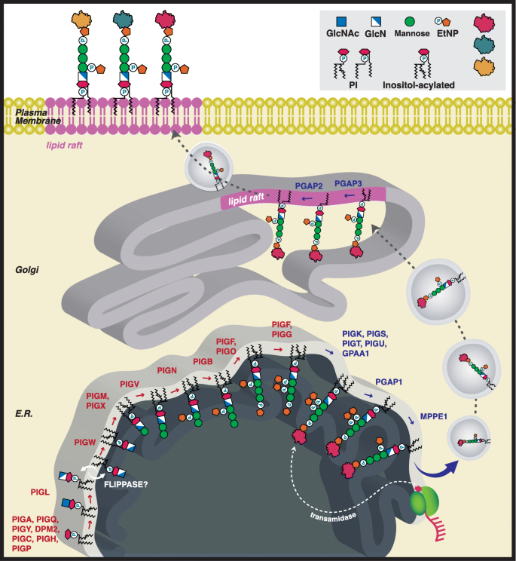
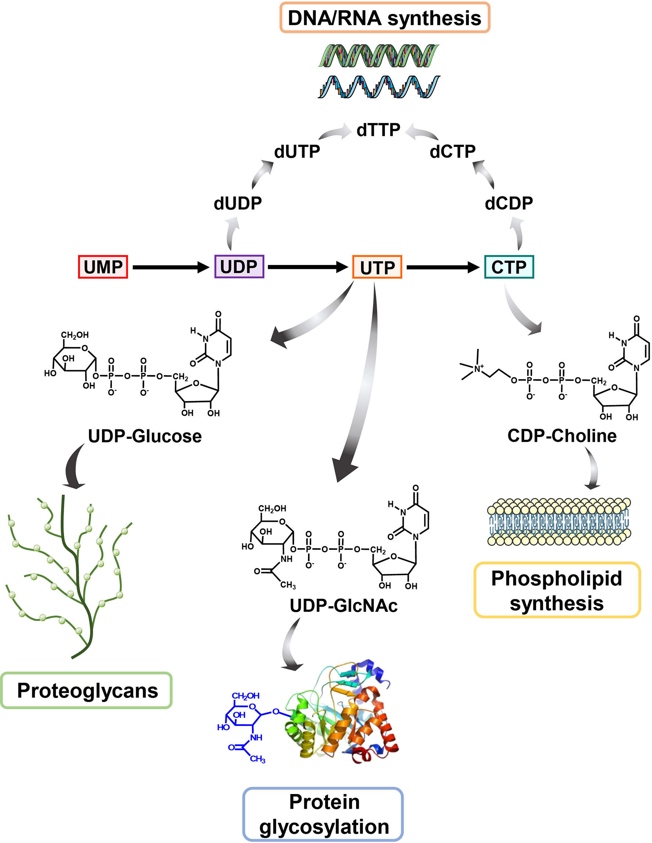
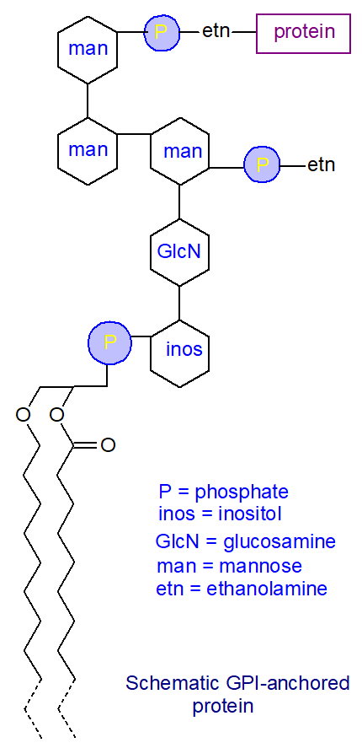
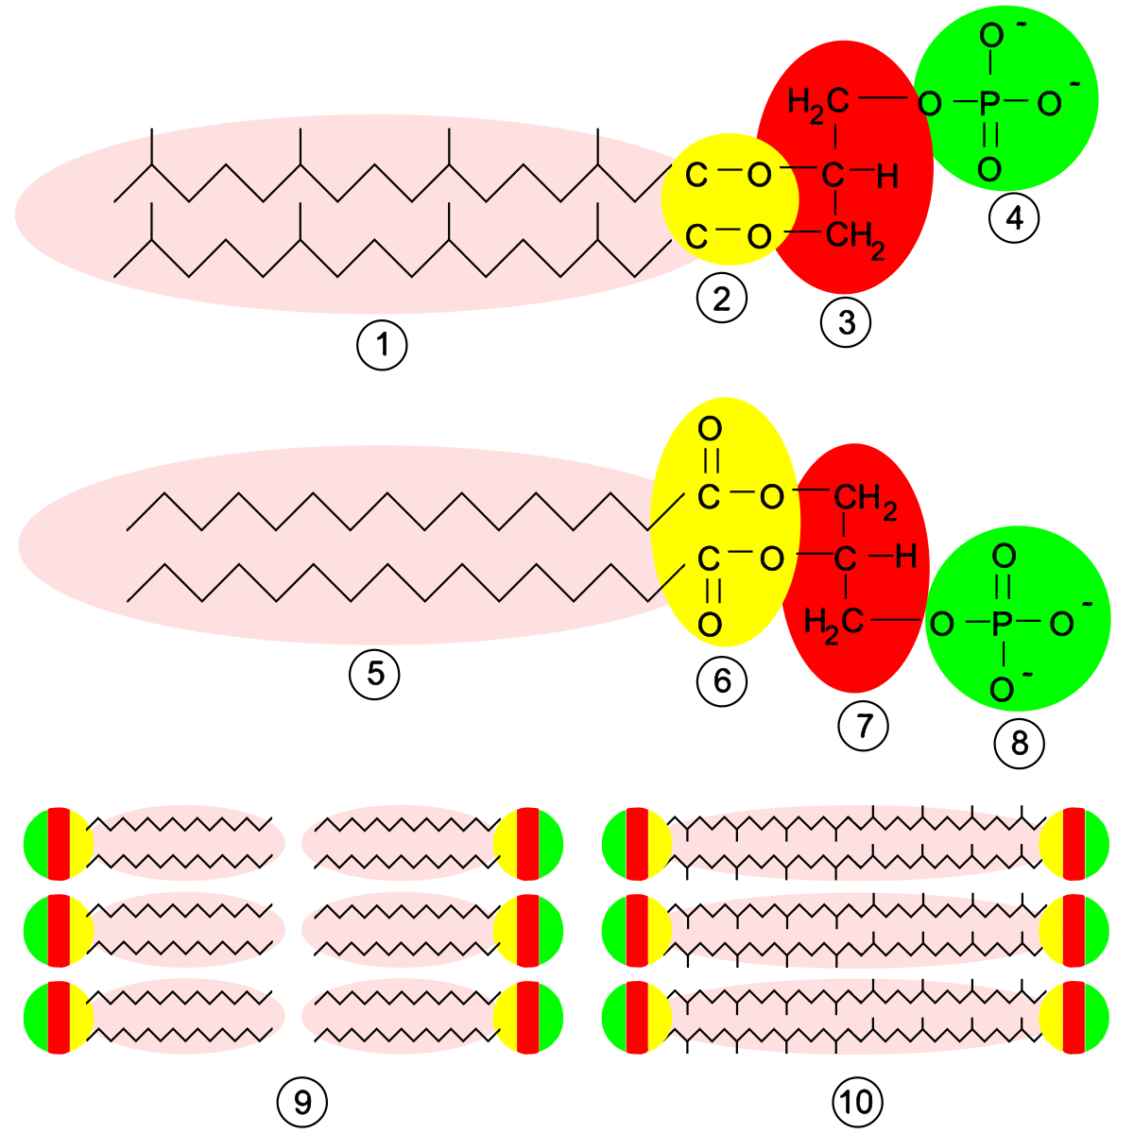
Green: GPI ( glycosylphosphatidylinositol ) anchor biosynthetic and metabolic process
Blue: Nucleoside phosphate metabolic process
Red: OXPHOS system in mitochondria
Purple: Biosynthesis of cofactors
Yellow: Pyrimidine and RNA metabolism
Orange: Organophosphate and Carbohydrate derivative process
Grey: Lipid biosynthetic process with alcohol group as acceptor and Kinase activity
Pink: Phospholipid biosynthetic process and metabolic process
Brown: Glycerophospholipid biosynthesis

Slide 14
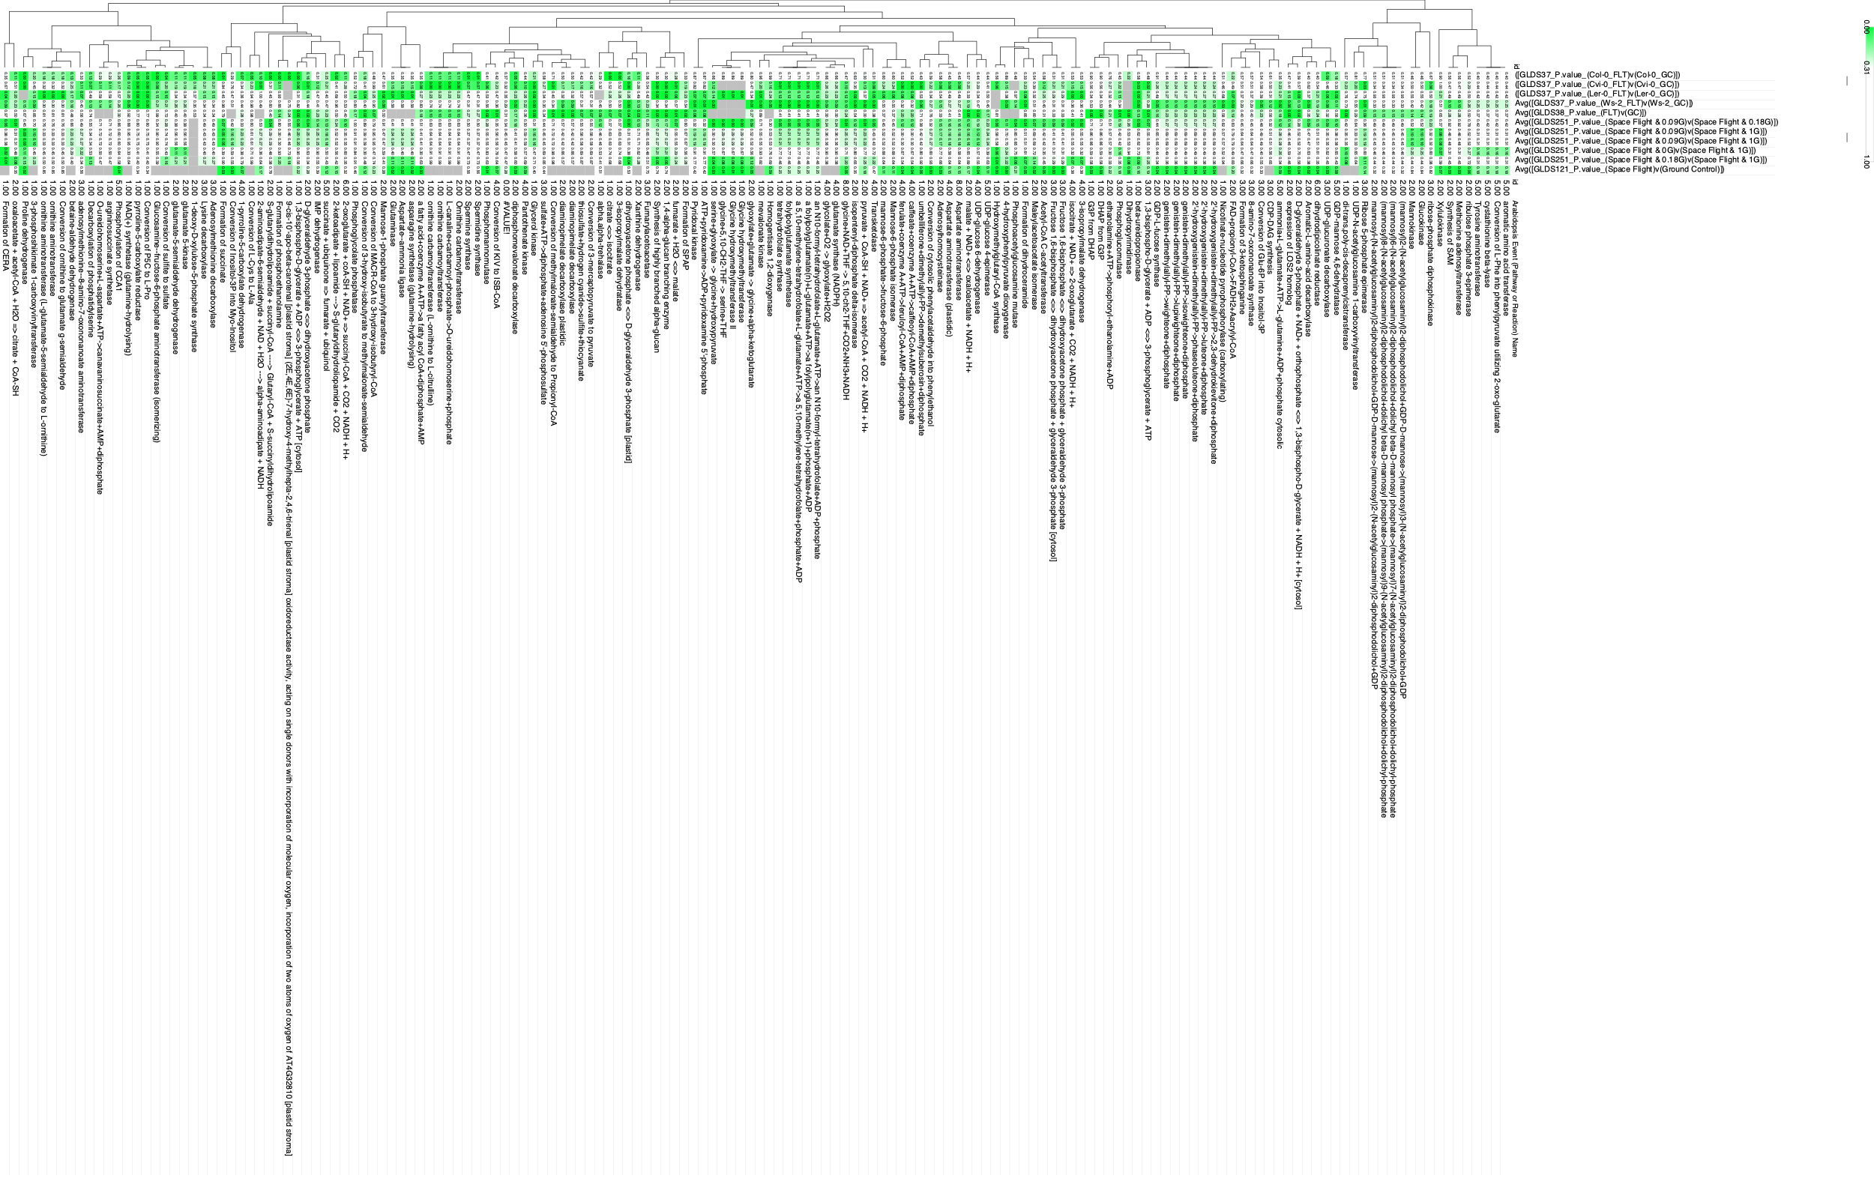
So then we use the the core KO reactions to look at spaceflight responses… Here’s the Arabidopsis example
466 conserved KO
812 loci
More green = More Significant
LogFC &/or Stat values could be used

Slide 15
https://www.sciencedirect.com/science/article/pii/S0261561418324269

Slide 16
Prototype / old figures after here

Slide 17
Human vs Arabidopsis & Fly vs Mouse
Green is all 4

Slide 18
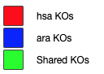
Human vs Arabidopsis

Slide 19
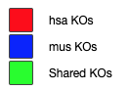
Human vs Mouse

Slide 20
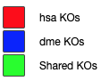
Human vs Fly

Slide 21
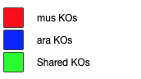
Mouse vs Arabidopsis

Slide 22
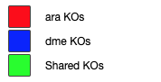
Arabidopsis vs fly

Slide 23
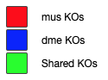
Fly vs Mouse

Slide 24
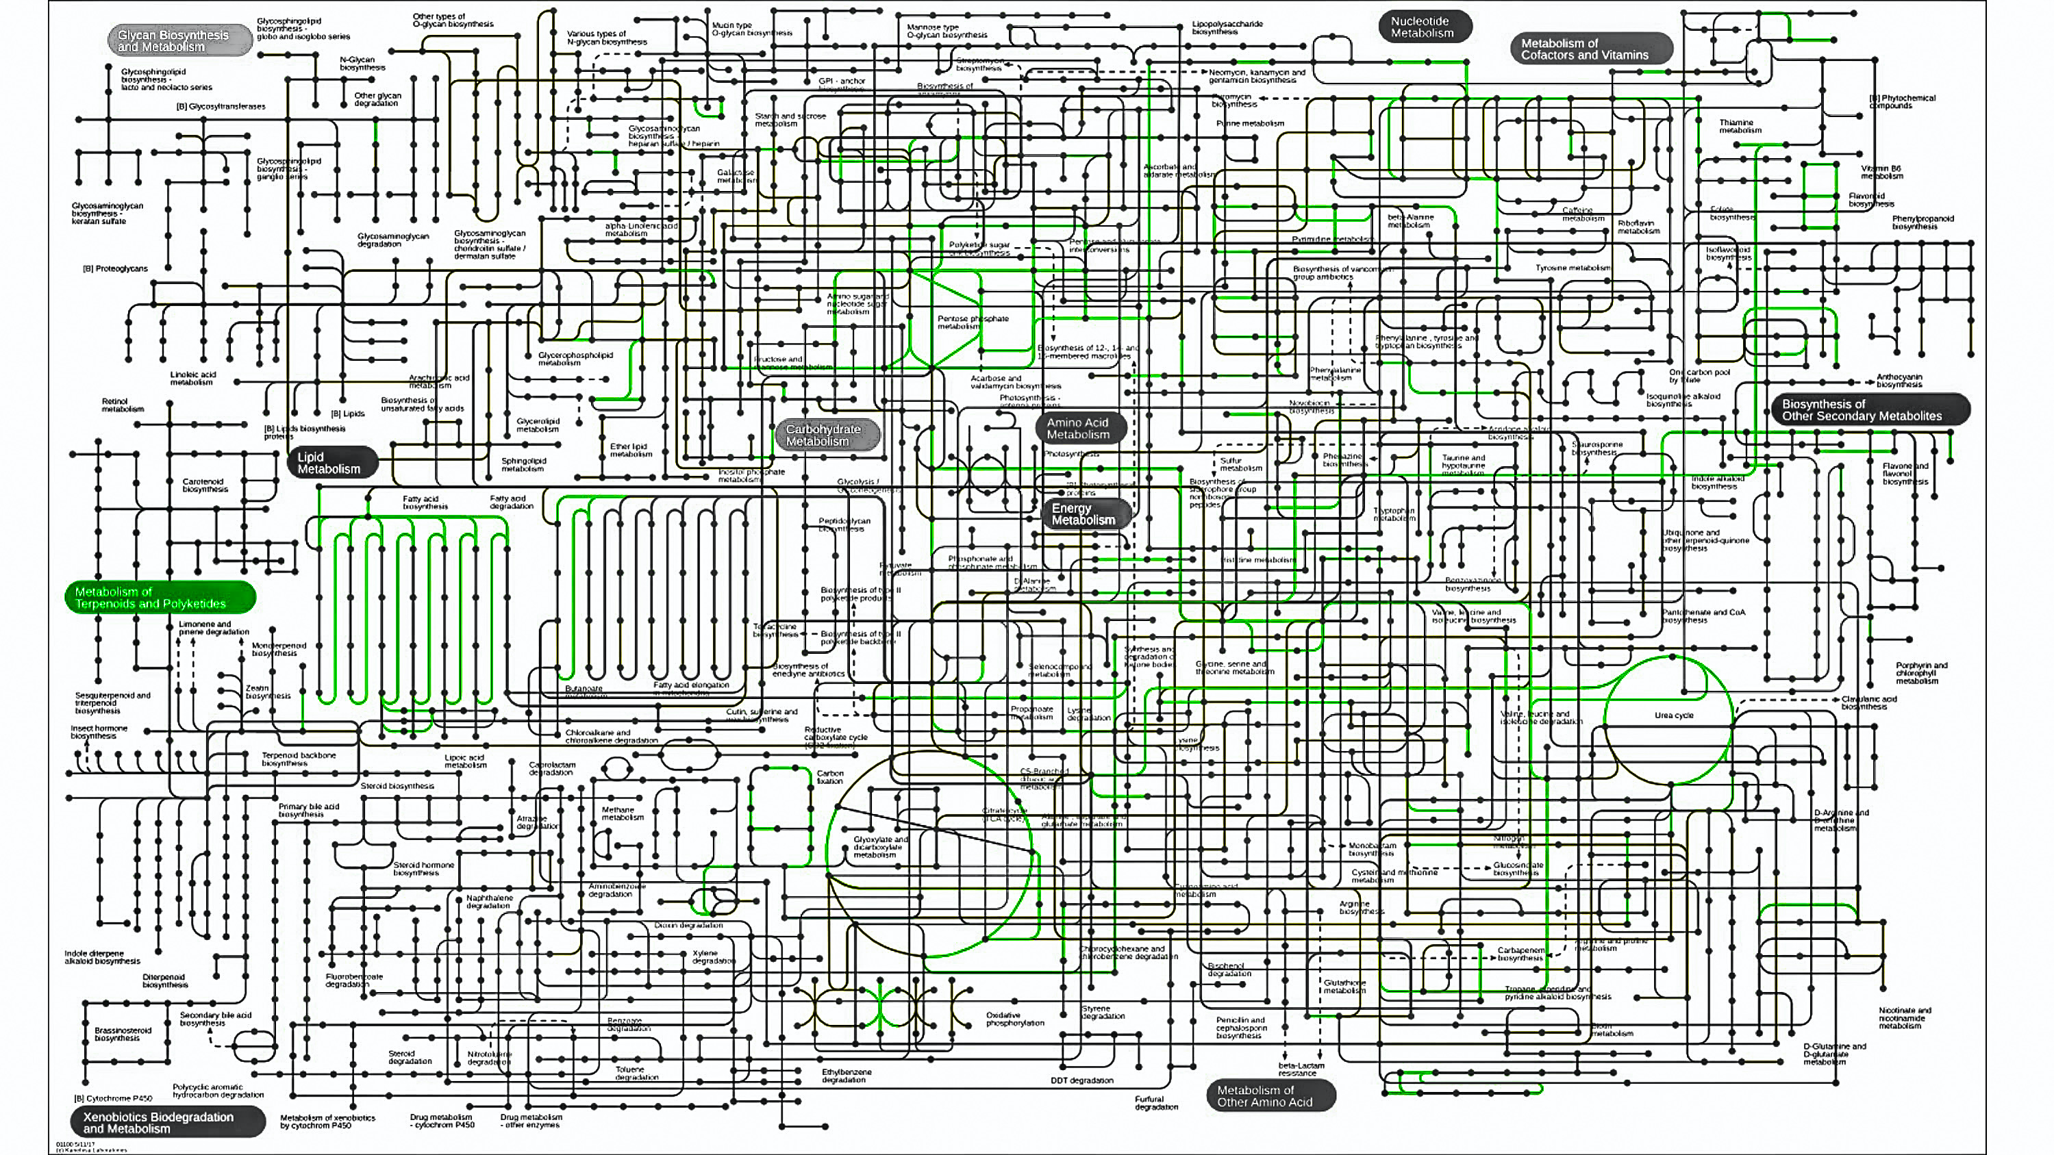
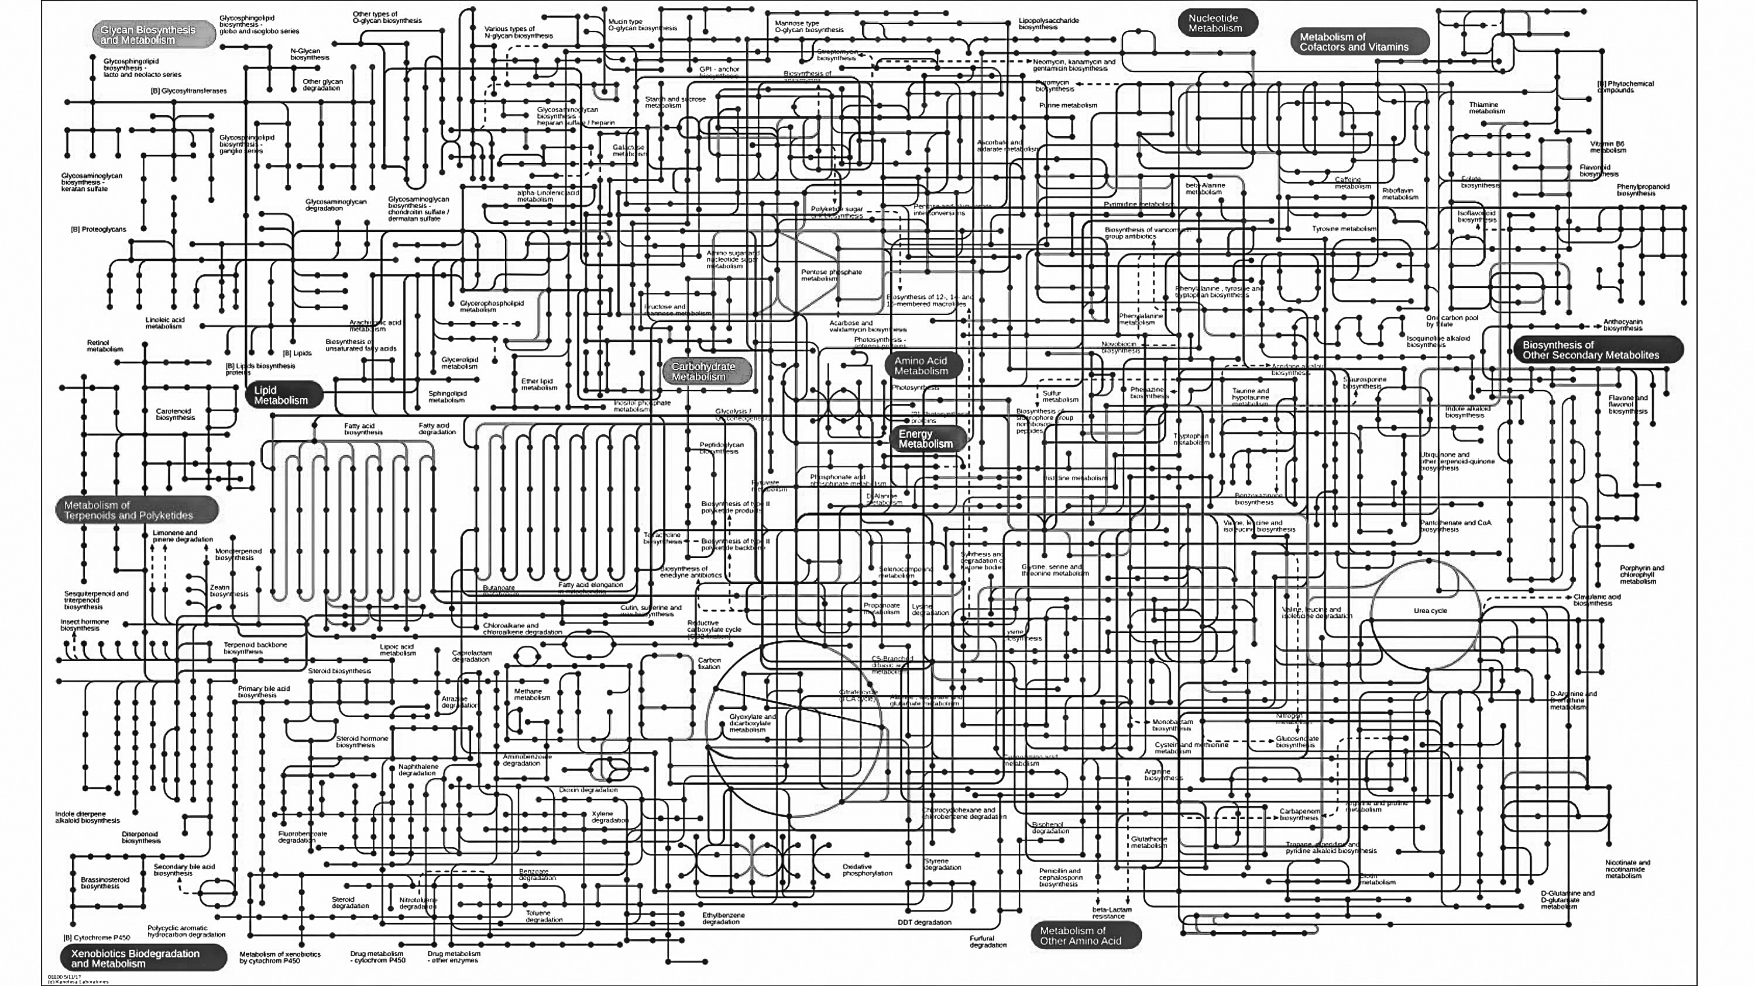
iPath3 Meta: Human vs Arabidopsis & Fly vs Mouse
Green is all 4

Slide 25
Human & Arabidopsis & Fly & Mouse
Lipid and Pentose metabolism
“Core carbon metabolism”
Mitochondrial function
Protein synthesis rates
Circadian rhythm
Green is all 4

Slide 26
Human & Arabidopsis & Fly & Mouse
Lipid and Pentose metabolism
“Core carbon metabolism”
Mitochondrial function
Protein synthesis rates
Circadian rhythm
Insert at heat map here showing
SIG PC pathway enrichment?
SIG loci that are conserved across species?
Green is all 4

Slide 27
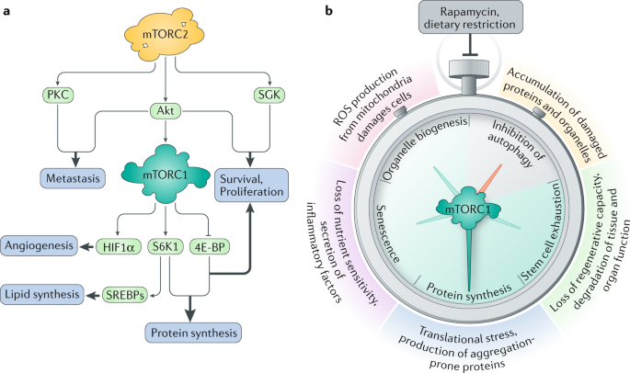
Carb vs Lipid
Aerobic vs Anaerobic

Slide 28
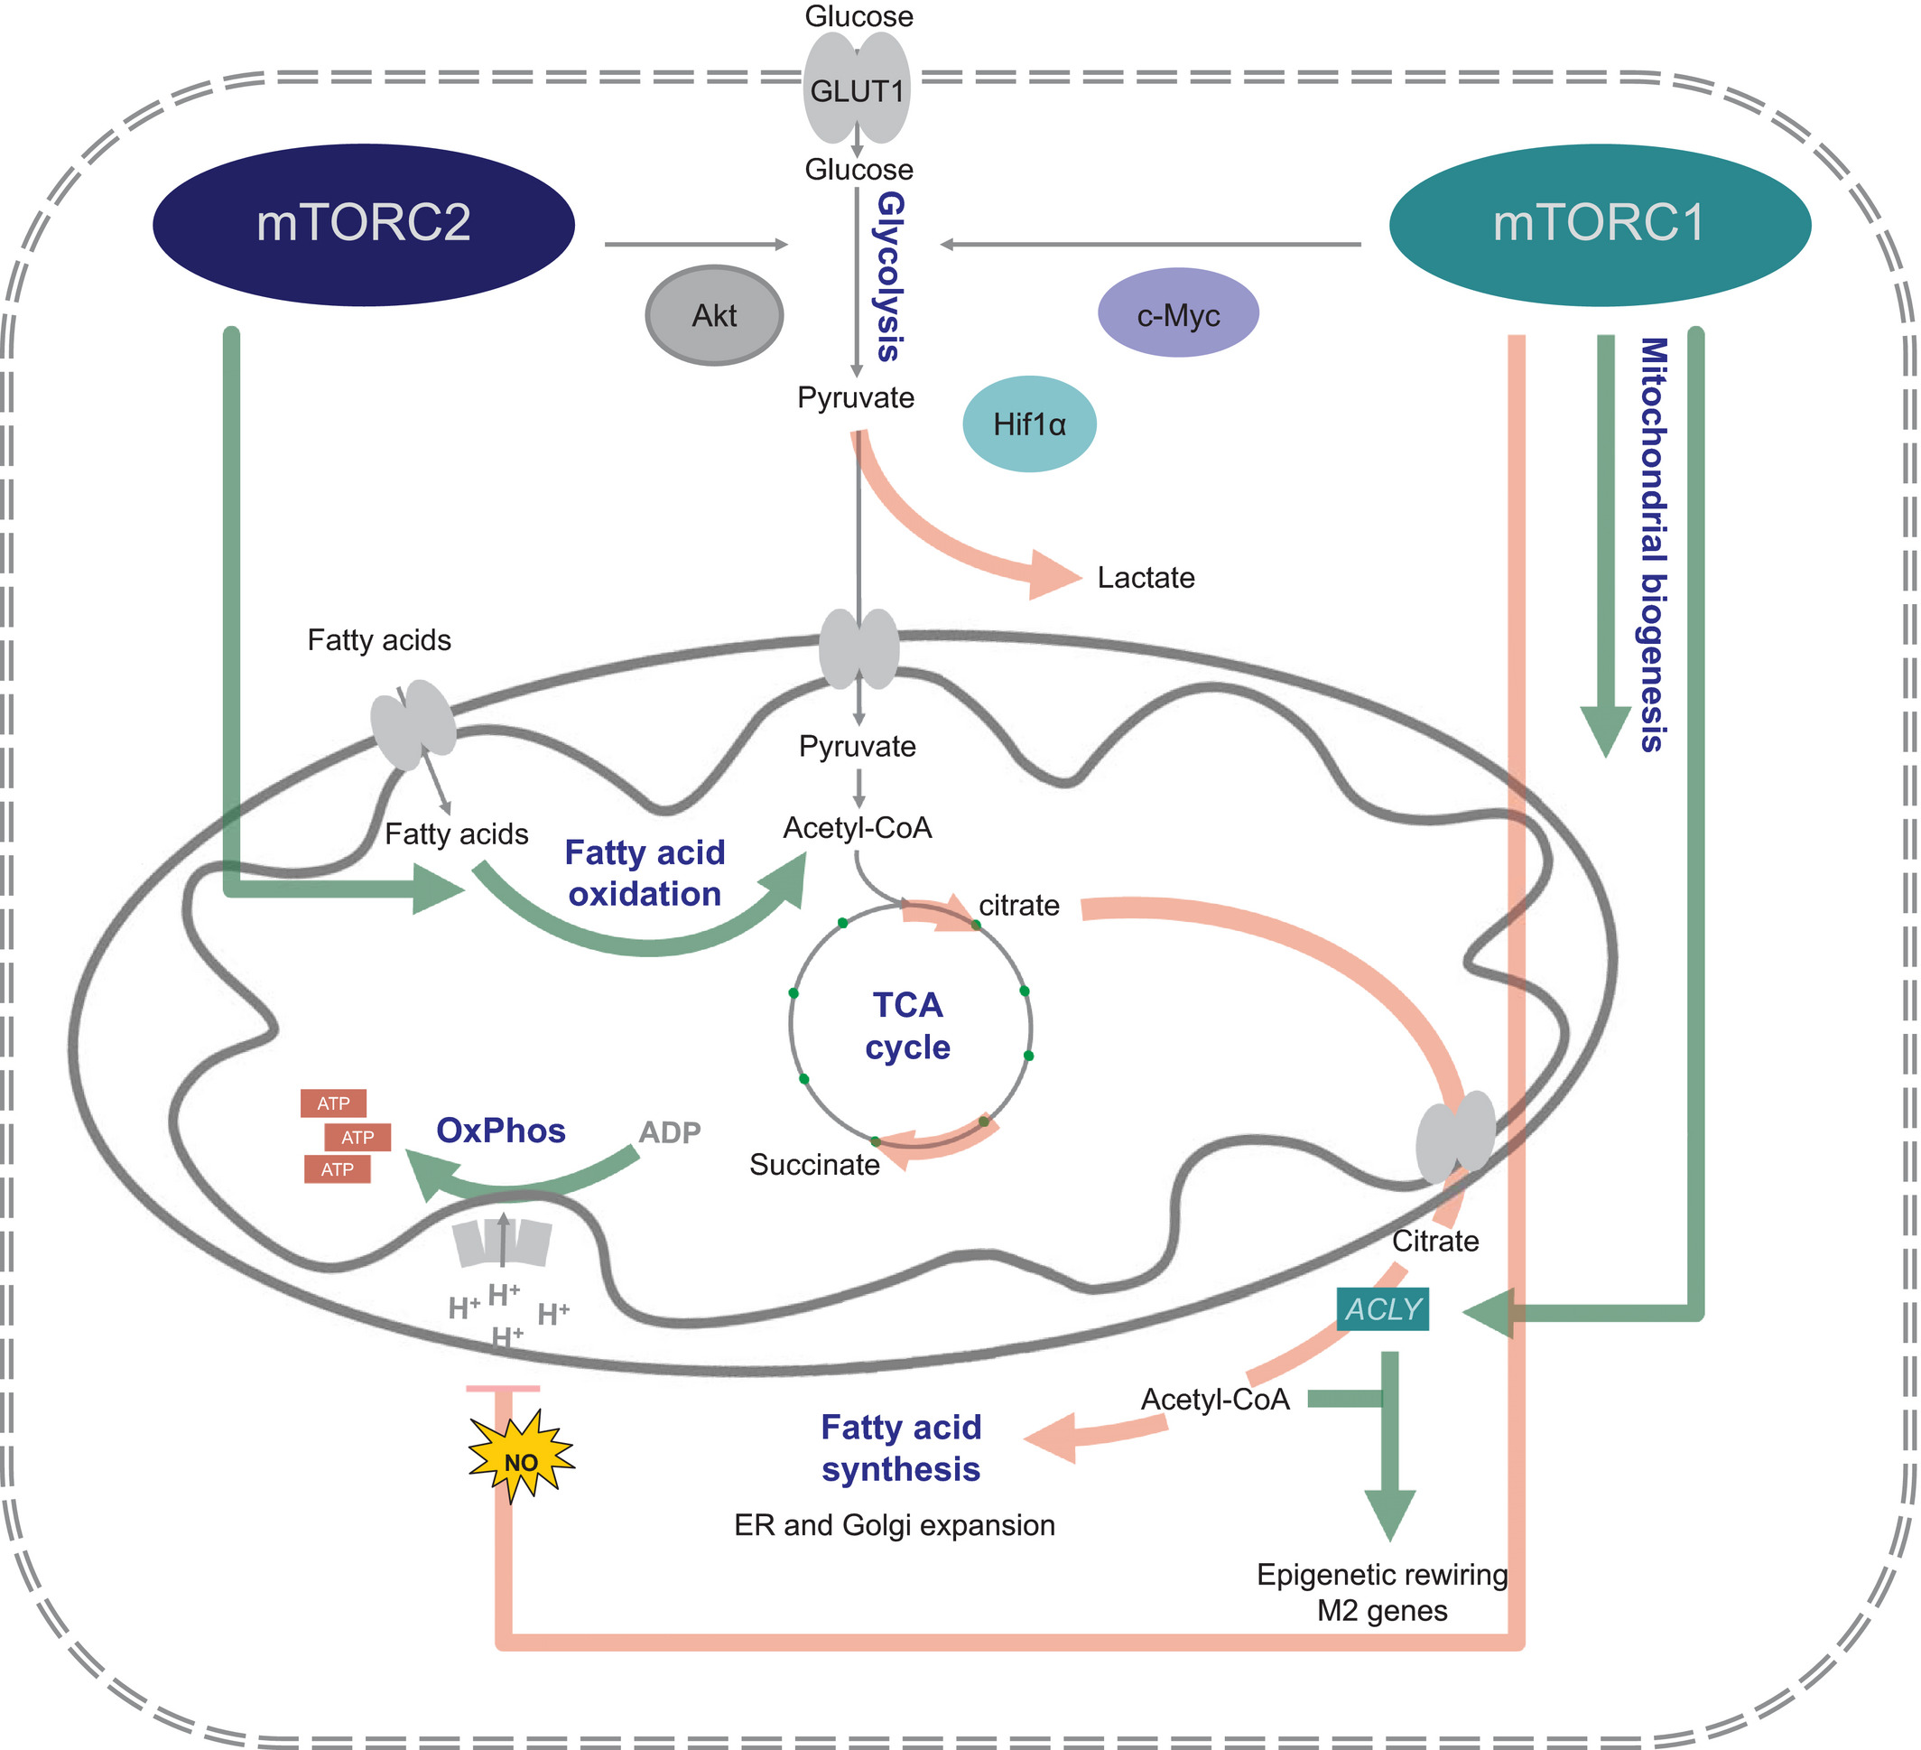
https://febs.onlinelibrary.wiley.com/doi/10.1002/1873-3468.12711

Slide 29
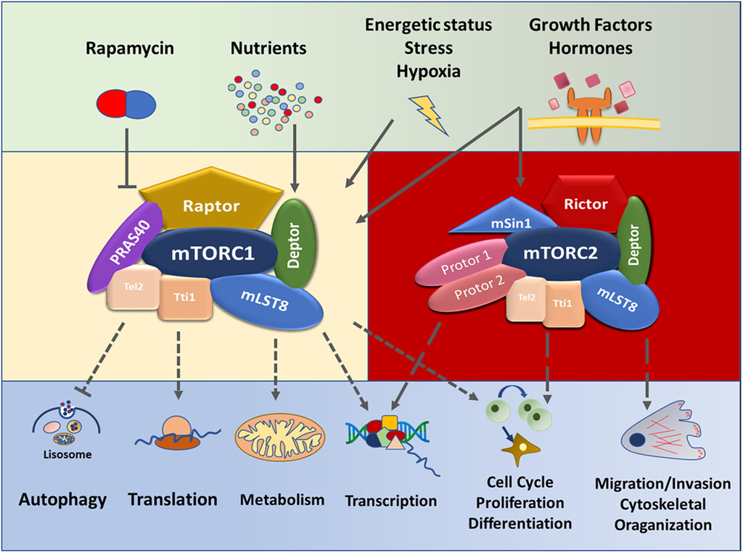
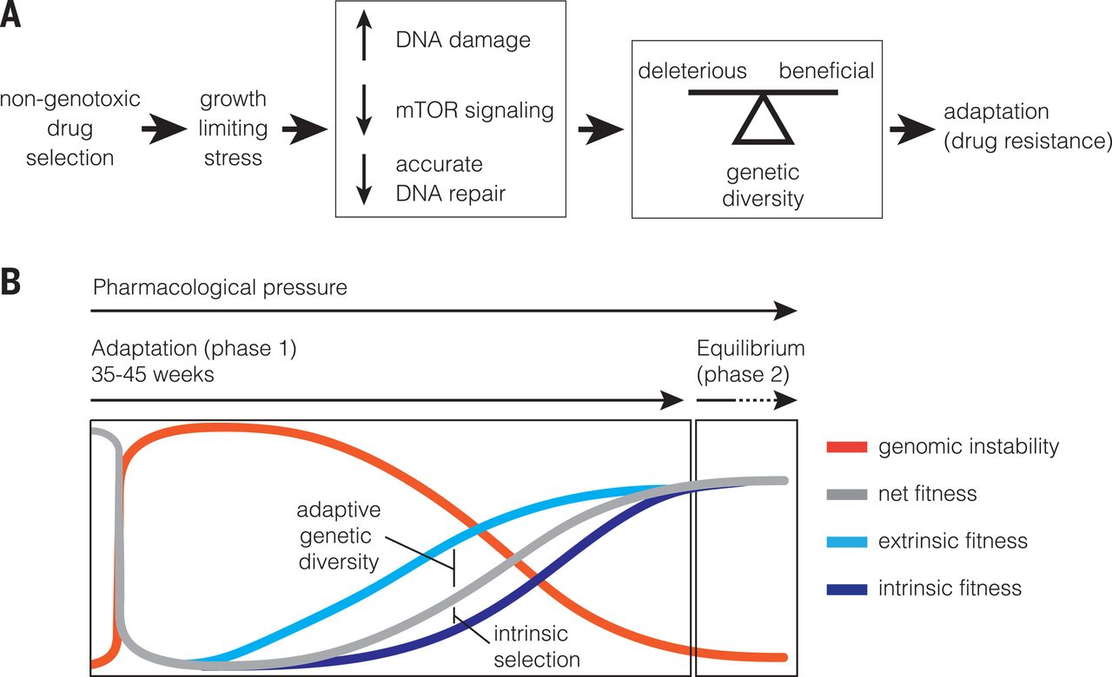
mTOR

Slide 30
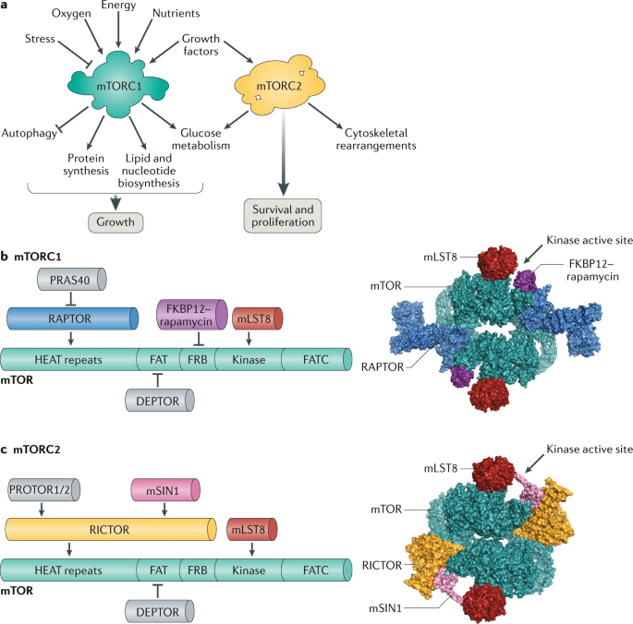

Slide 31
